Slide 1

Measuring Changes in Media Bias using Natural Language Processing AI
Christopher Thomas Edmunds
17024395
Notes:
Hi there, my name is Christopher Edmunds, and this is a brief presentation to explain, in broad strokes, the purpose of my project and how it functions.

Slide 2



Agenda
Why Measure Changes in bias?
Sourcing Data
Measuring Bias
Processing Data
Storing Data
Displaying Data
Demonstration
Questions

Slide 3




Introduction
Within the current political and socioeconomic climate, media bias is a particularly hot-topic.
Many people believe media bias has spiraled out of control and needs to be corrected
However, tracking media bias in the first place is a difficult task, necessitating novel solutions
Notes:
There exists today a significant amount of discussion and study around the topic of media bias. Increasing political polarization has led media to follow suit and itself become increasingly polarized and biased in its coverage.

Slide 4

Why Measure changes in bias?
What was the motivation behind this project?
Notes:
This has lead to many attempts at objectively measuring metrics of bias in media, attempt this is ours.

Slide 5
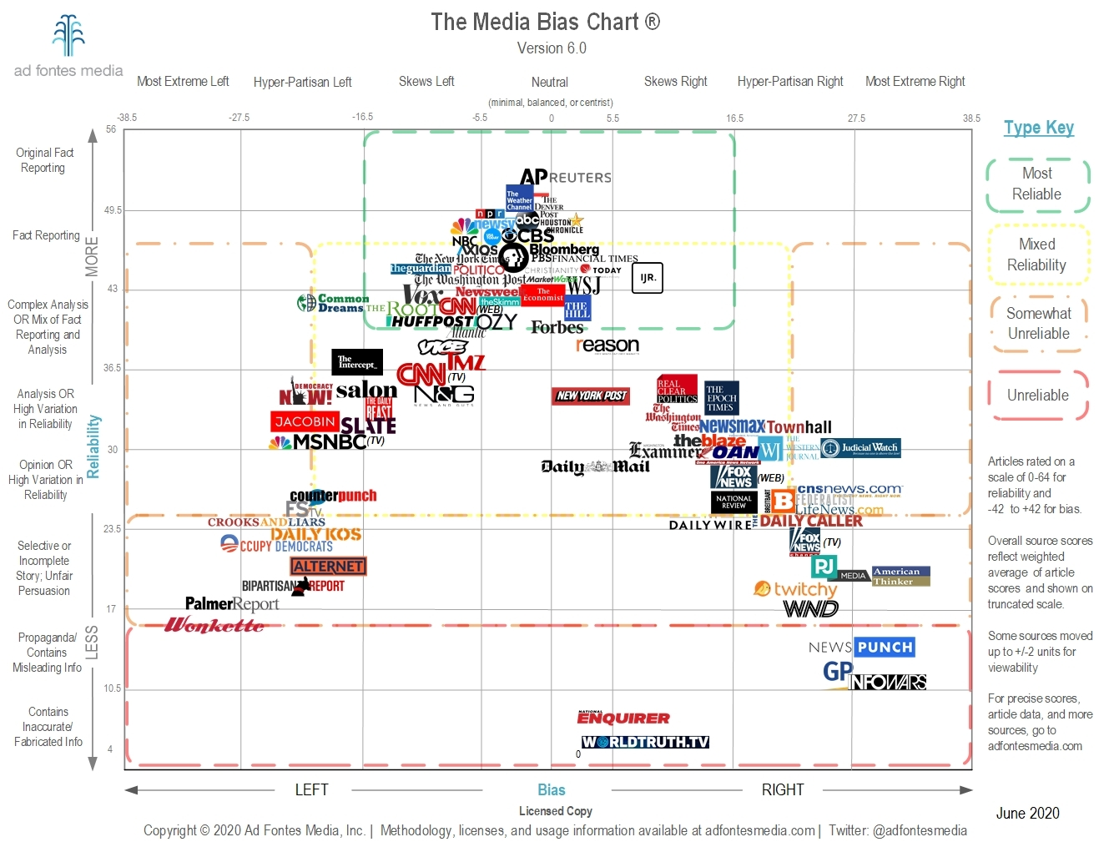
What Effect does bias have?
Studies have suggested media bias can influence the results of elections
Studies have additionally shown that bias in media can incite discrimination and violence in individuals
Bias in media has significant incentives despite this
Notes:
There exist a wide range of consequences in allowing media to become more biased. Biased media has been linked to numerous societal issues, such as increased frequency of violence, specifically against marginalized groups, Altered voting patterns in locations shown biased media and an Increased spread of disinformation

Slide 6

Can Bias be combatted?
Individuals are very poor at recognizing their own bias
When made aware of bias in the media consumed, individuals are generally less affected by it
Notes:
However, despite the difficulties in defining bias, it can be combatted. Studies have shown that when an individual is shown the bias of a news source they use, they are generally much less effected by it. The issue lies in individuals inability to recognize that bias without some form of external aid. That is where our program comes in.

Slide 7

What is the goal of our project?
To measure changes in bias over time in the news
To display that data in an easy to use, easy to understand format.
Notes:
The purpose of our program is to measure the bias, and bias trends, of news media organizations by tracking the sentiment of their articles towards all of the key figures named in those articles. This is then displayed in a user friendly searchable format to allow any user to learn about the biases of the media organizations they use and, hopefully, in turn become less directly influenced by it.

Slide 8
Sourcing Data
What news group did we choose, and how did we get the data to use?
Notes:
The first part of our program is sourcing the data. We chose to focus on web based news so we need to source articles from the internet so we can process them.

Slide 9
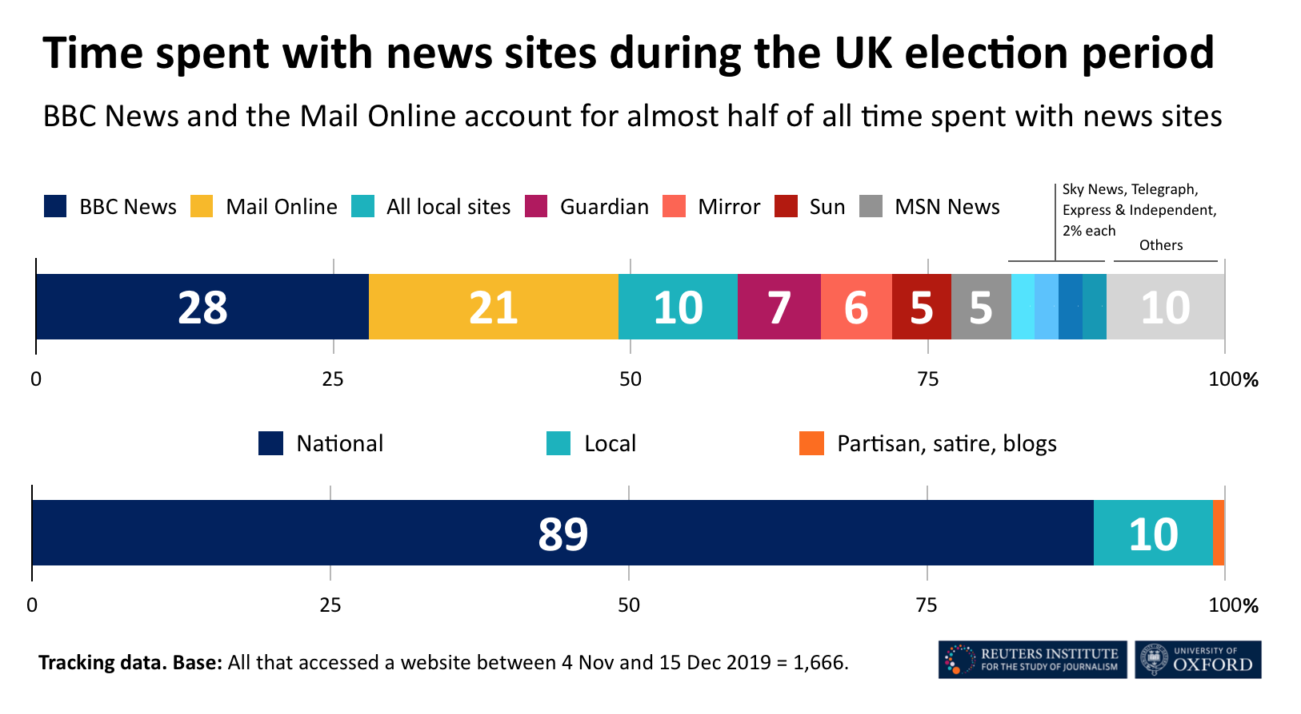
Why the BBC?
The BBC is generally considered a relatively impartial organization
Its extreme popularity makes it an important source to study
It specifically becomes popular regarding election coverage
Notes:
We selected the BBC as the primary media group for this experiment due to their general good reputation for impartiality, which should provide pretty consistent informative data, as well as its popularity, easy to understand website, and its relevance to important coverage such as elections

Slide 10



What tools did we use?
A HTML parsing library used for web crawling
Capable of quickly parsing through websites HTML data to retrieve what we need
A HTTP requests library used for accessing web pages programmatically
Used for connecting to the websites we need
Notes:
We utilized two major libraries for this, Beautiful soup, a HTML parser which we used to separate out the important parts of the HTML webpages we were accessing. And Requests a library used for making HTTP requests to specific URL’s to access the HTML of the webpages at those URL’s

Slide 11

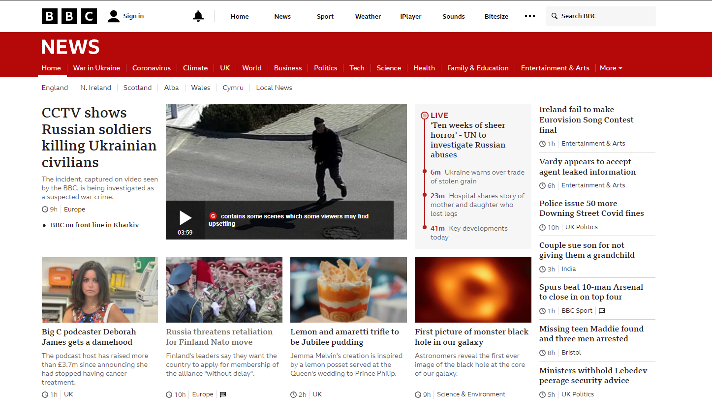
Web Crawling
Notes:
Here we can see the BBC News front page. It looks relatively complex at a first glace but in fact we only need a very specific part of it

Slide 12
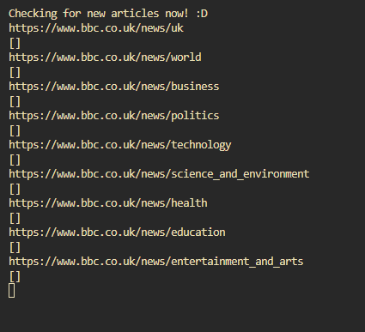
Web Crawling
Notes:
Each of these subheading's links to a parent URL under which every article the BBC news creates is posted. Some articles are posted under multiple of these subheadings but all articles will be posted under at least one of them.

Slide 13
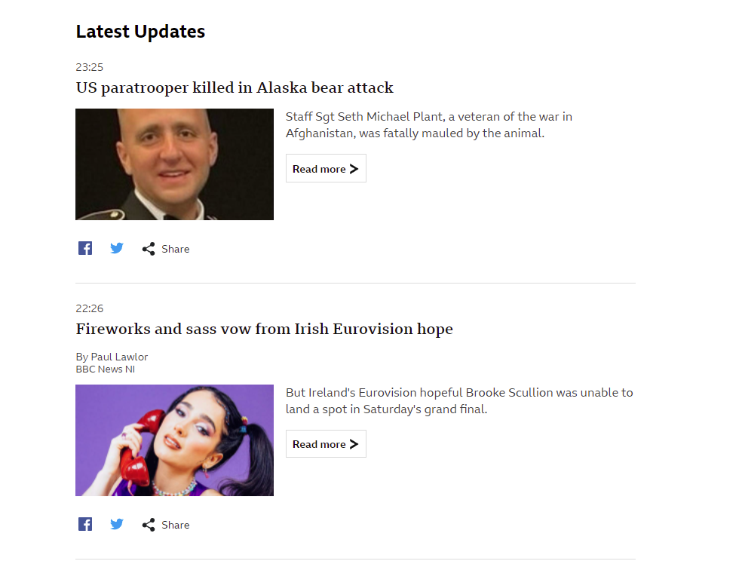
Web Crawling
Notes:
While using the BBC’s search functionality in a web scraper is prohibited and will result in your connection being blocked, accessing their Latest Updates section is not. Under this section every new article posted under a subheading is posted. Unfortunately, articles are reposted here when they are updated for errors, however the implementation of a simple backlog file prevents this from being an issue

Slide 14

Web Crawling
Notes:
Now that we have a list of URLs of all new articles, we can access these articles programmatically and begin accessing the data we need

Slide 15
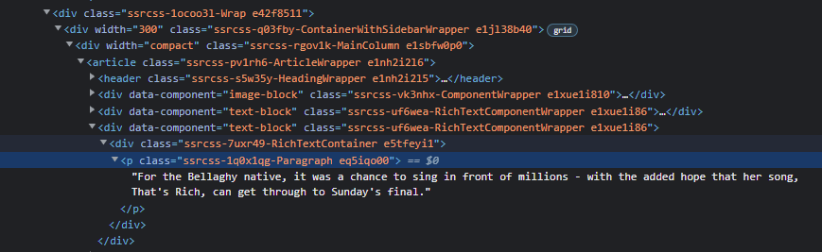
Web Crawling
Notes:
Within each of these individual articles, the body of text is stored within these paragraph classes. By using Beautiful soup, we can access only this data and discard the rest. Eventually giving us a single string containing only the body of the text in its entirety. This can then be simply broken into sentences and returned as an array of sentences to be processed.

Slide 16
Measuring Bias
How did we measure bias, and what tools did we use?
Notes:
Now that we have an article broken down into an array of sentences, we can begin to process them.

Slide 17



How have we measured bias?
Our primary metric for measuring bias is Sentiment
We measured how positive or negative the BBC was about key figures over time
We processed every sentence, in every article posted since we started running.
We found the key figure of every sentence, as well as its sentiment.
We used a Rule-Based model for sentiment analysis
Notes:
First each sentence has to have its sentiment appraised, we used a predesigned Rule Based model which utilizes a lexicon of words, particularly adjectives, with assigned sentiment values. This outputs a total sentiment for the sentence as a float variable from 1 to -1

Slide 18

How we selected a key figure?
We used a machine learning based model
Our NER was a deep convolutional neural network
Each sentence was processed to see which named entities of certain types were present
If none were present, it was tagged as “figurenotfound”
Notes:
Next each sentence must have its key figure detected. For this we used a prebuilt Named Entity Recognition model which utilizes a deep convolutional neural network. This provides us with a list of all of the named entities within the sentence, as well as the type of named entity for example organisation, person or religious group. Finally if it doesn’t recognise any named entity it simply tags the sentence as figurenotfound

Slide 19


What tools did we use?
A machine learning and NLP toolkit in python
Based on the more classic NLTK library
Considerably more performative than its predecessor
Used for Named Entity Recognition
A machine learning and NLP toolkit in python
Based on the Pattern Library
Used for Sentiment analysis
Notes:
For these natural language processing tasks we utilized two machine learning and natural language processing libraries. Spaccy and Textblob. Spaccy was utilized for the machine learning based named entity recognition and Textblob for the rule based sentiment analysis. Both were utilized for similar reasons, performativeness, ease of use, and compatibility with the other tools being used.

Slide 20
Processing Data
How did we process our data into a usable format?
Notes:
Now that we have our sentiment and named entities for every sentence in our articles. We need to begin processing this down into usable data.

Slide 21

Selecting which key-figure to use
First Noun Principle: “learners tend to process the first noun or pronoun they encounter in a sentence as the subject or agent.”
Plural Noun Scale: Nouns that refer to groups rather than individuals, placed on a hierarchy of scale
We narrow down our choice of named entity types to “Organization”, “Geopolitical Entity”, “Person”, “Nationalities or religious or political groups”
These are ordered by scale
Person > Organization > NRPG > GPE
Notes:
The first step is to select which of the named entities in a sentence detected by our model, we should actually consider to be the subject of the sentence. We do this using two linguistic rules. The first noun principle which suggests that the first noun or named entity in a sentence is likely to be the subject of the sentence and the plural noun scale, which recognizes that certain nouns refer to groups rather than individuals, and the larger the scale of the group the less likely it is to be the subject of the sentence. Therefore we can presume that the named entity which is lowest on the scale is likely to be the subject, but if there are multiples on the same level of the scale, the first is likely the subject.

Slide 22
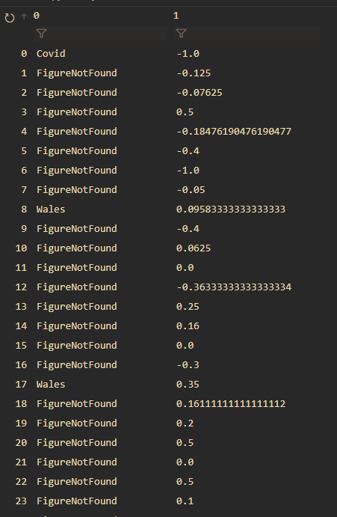
Average out every instance of an individual
Every named entity that was selected was combined
Their sentiments were averaged out
This made values for the article as a whole
Notes:
Here we can see that we now have a big table of our final key figures, as well as their associated sentiments. These occurrences of key figures and their sentiments need to be combined and averaged out to generate their metric for sentiment in the article as a whole

Slide 23
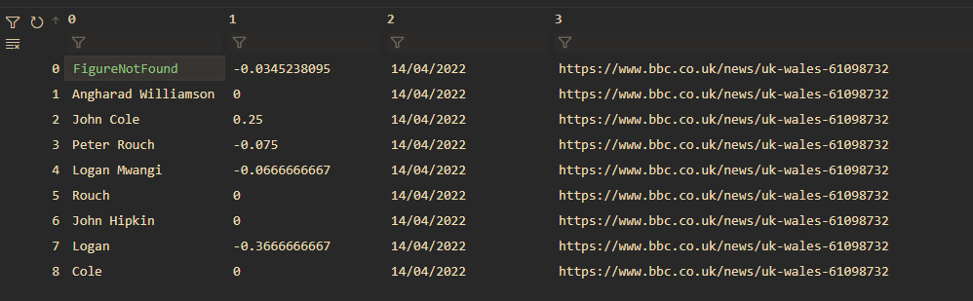
Averaged Data
Notes:
Now that we have combined the data we can see that is much more usable. Representing how positive the news organization is about the individual in question at a specific date. There does however still exist the figurenotfound value for the article, we will use this next

Slide 24

Weighting The Data
Sentiment of all sentences with no key figure are collected
These sentiments are averaged out
This value is used to weight the sentiments of named entities
This prevents negative articles about individuals being mislabeled
Notes:
It is possible, for an article to be extremely negative about an individual but in the sentences that directly mention them, only be neutral or even slightly positive. Therefore we need to use the articles sentiment as a whole to weight all of the data we have obtained so as to provide a more accurate picture. To do this we take the sentiment value for figurenotfound and increase or decrease all of the sentiments recorded for the article by a portion of that amount, in our current iteration we weight by about 10%

Slide 25
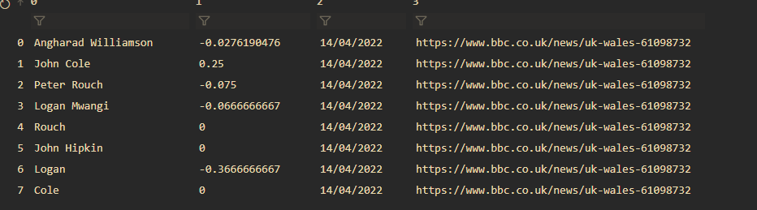
Formatting the final data
Each key figure is stored as four pieces of data
Name
Sentiment
Date of article
Article URL
Notes:
Here we can see the weighted data, with its associated date and Article url attached. This is the finalized data which can now be entered into the database.

Slide 26
Storing The Data
How was the data stored?
Notes:
Next we need to store the data in the database. This is a relatively simple aspect of the project.

Slide 27


What tools did we use?
A simple fast SQL database engine
Used for creating, saving to, and accessing the database
A simple browser for modifying and viewing the contents of our SQLite table
A simple workaround for rapid development
DB Browser
Notes:
We utilized SQLite to build and access a database. As well as DB Browser to make managing it easier over time. These are simple and lightweight, and local to the machine so ideal for this project.

Slide 28
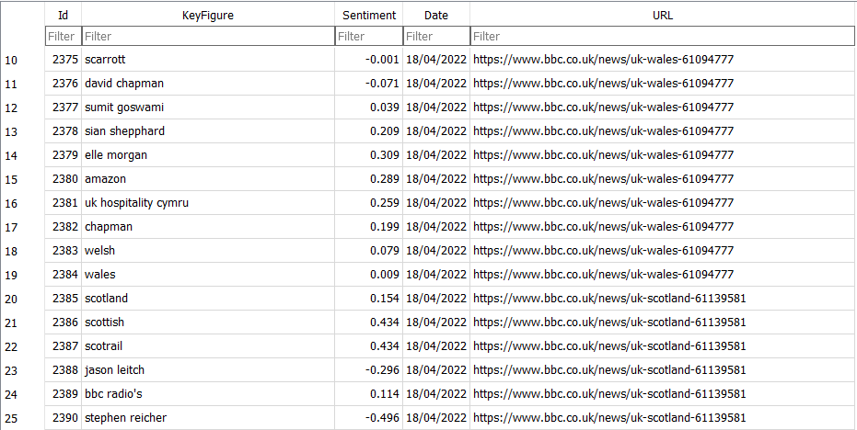
Final Database
Notes:
Here we can see an excerpt fromt eh final database, with all of the data that we want to use. Now we need to give a user a way to view it.

Slide 29
Displaying Data
How did we display this data for users to utilize?
Notes:
To display the data we wanted to utilize a web page, which can generate a graph of the sentiment over time of a key figure entered into the web page. This utilizes a fair few tools which took a significant amount of time to develop, but lacks any unusual logic or methodologies, so we wont linger on this aspect too long.

Slide 30


What tools did we use?
A web server framework
Used for creating the web server our web page is hosted on
Performative and simple to use
A HTML, CSS and JS library used to “prettify” the web pages
Useful for making a responsive website rapidly
Notes:
We built our project on a flask server, this is a framework for hosting our webpage as well as connecting the various components together. Additionally we utilized bootstrap to make the website aesthetically pleasing and allow for reactive functionality

Slide 31


What tools did we use?
A charting graphic library
Visually attractive and impressive charts
The single biggest regret of this project
Chart.js
A toolkit for enabling more flexible use of SQLite
Essential for connecting the database to the flask server
Notes:
Additionally we used chartJS to generate the charts. Which would turn out to be an unfvortunate choice, as its documentation and functionality is extremely lacking, but regardless it was our choice. Additionally we utilized SQLAlchemy as a tool for connecting our flask server to our Sqlite database quickly and easily, as well as supporting complex search queries.

Slide 32
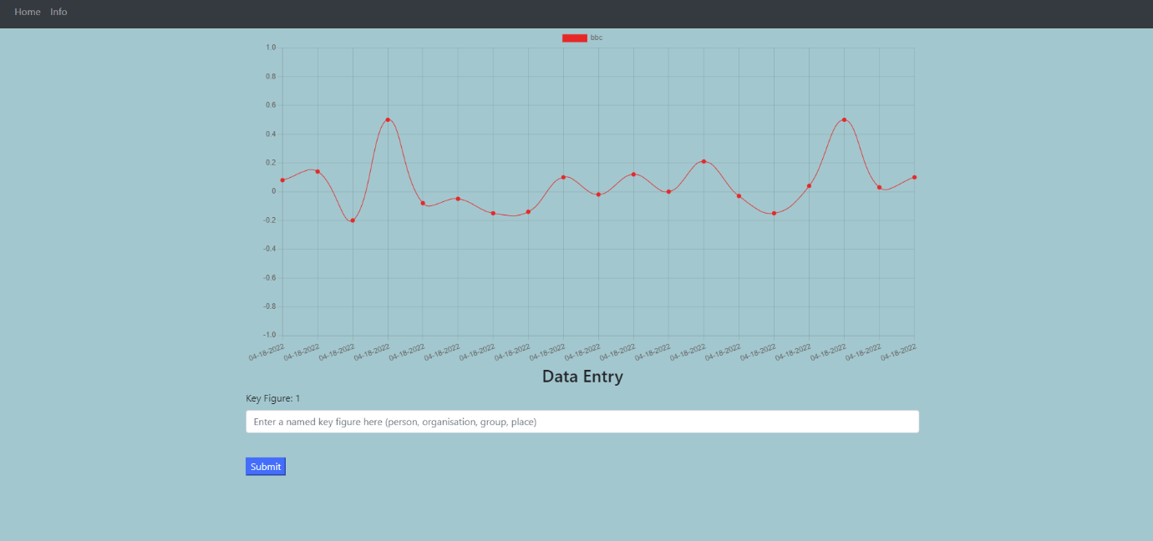
Notes:
Utilizing these various tools we were able to create this web page. Any user accessing this page can enter a key figure of their choosing who has appeared in the news within the timeframe of the program running, and see a graph of their sentiment over time. This will hopefully prove extremely informative to the user in allowing them to discern if the BBC has been unusually positive or negative when discussing their key figure of choice.

Slide 33


Time for the demonstration!
Christopher Thomas Edmunds
Christopher2.Edmunds@live.uwe.ac.uk
Notes:
Thank you for listening, on to the demonstraition!

